Slide 1

Data Mining/Machine Learning
Personalized Tourism Itinerary Recommender System
Guide: Dr. B Narsing Rao
Team:
Chiranth Gopal K 1PI13CS047
Gourish Hebbar 1PI13CS062
Dept of CSE Jan - May 2017

Slide 2
Data Mining/Machine Learning
Problem Statement
To provide personalized itinerary for attractions based on user location and preferences
Dept of CSE Jan - May 2017

Slide 3
Data Mining/Machine Learning
Solution
To build a web app using a recommendation engine which generates a path of places to be visited in particular order
Dept of CSE Jan - May 2017

Slide 4
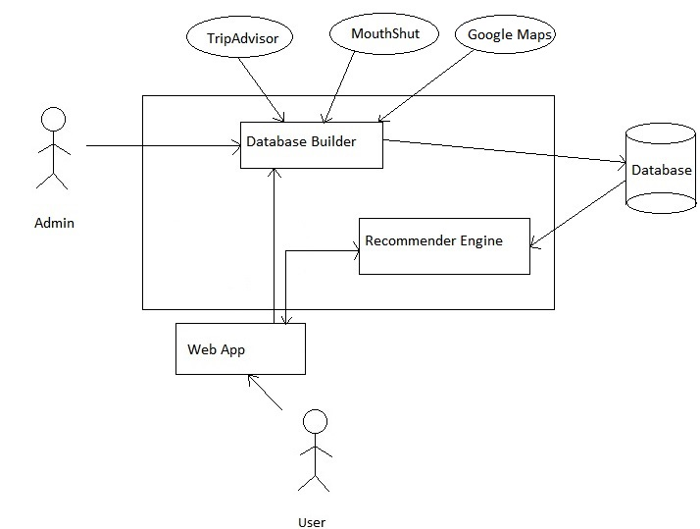
Data Mining/Machine Learning
High Level Architecture
Dept of CSE Jan - May 2017

Slide 5
Data Mining/Machine Learning
Brief Overview
Show user recommended places with ratings and suggested time to be spent on the place on a map
Also show other recommendations as a list of places
User can
Modify the time they would want to spend at a place
Add/remove a place from their itinerary using the recommended places list
For stay of multiple days, places visited on the previous days will be excluded from further recommendations
Dept of CSE Jan - May 2017

Slide 6
Data Mining/Machine Learning
User inputs
Duration of stay
Start time for the day
End time for the day
Start/end point of the trip
Preferences of place
Dept of CSE Jan - May 2017

Slide 7
Progress Till Date
We have scraped data for places around Mysore and have stored it in MySQL
Columns of data we currently have are
Place name
Categories
Latitude
Longitude
URL for more details
Average time spent per visit (Manual input)

Slide 8
Progress Till Date
Front end:
User can select categories of places, can choose multiple of them, and as and when he selects, the relevant results of places are shown.
He can choose start/end location on the map by dropping a marker.
He can enter the date and time of the duration of visit
Results shown to the user contain the place name, along with the other details, sorted in the order of normalised ratings.
TheTripAdvisor link of the place is included in the name of the place.

Slide 9
Progress Till Date
Clicking anywhere else on the result of each place, will highlight the place on the map.
We give the user the recommended time to spend at the place, and also give a slider to edit the time to whatever duration the he would like to spend there.
Checkboxes are included so that the user can select which places he wants to visit and then we generate the places on the map, in the order of visit suitable, to maximise the profit.

Slide 10
Progress Till Date
Back end:
Based on the categories the user selects, an AJAX call goes to the backend.
We have a PHP backend file, which takes this request, opens a connection to the database, and fetches the data through a query and returns it to the front end
We take this data, and based on user selection of places, find the cost between edges.
We minimise the cost of edge between places and apply the travelling salesman problem.
Formula to calculate edge of cost:
Cost = a * duration of visit - b * rating + c * avg. time at place

